Slide 1

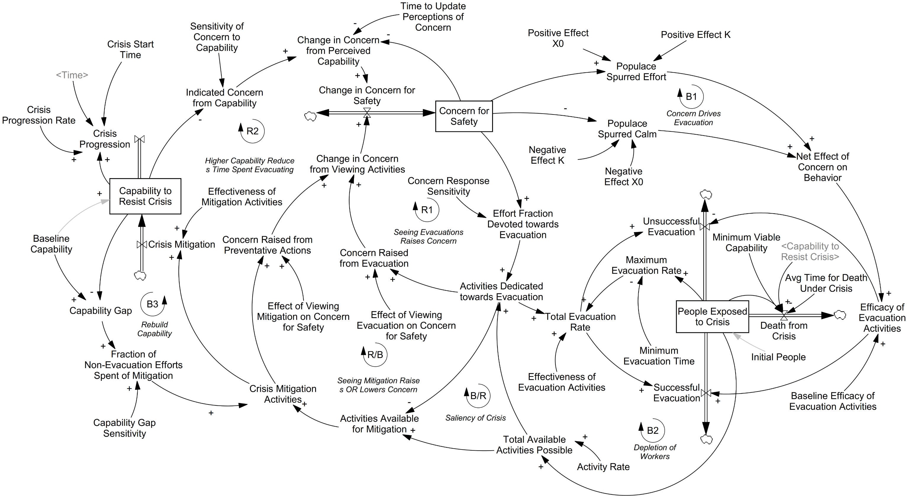
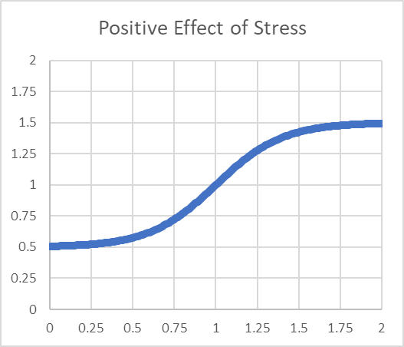
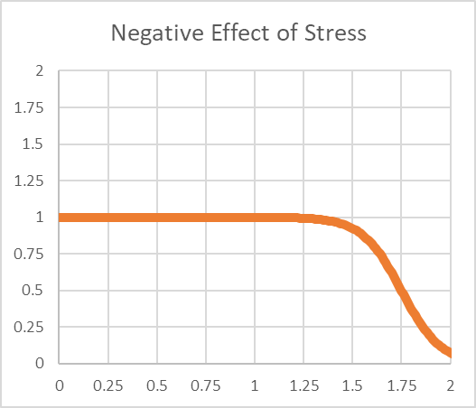
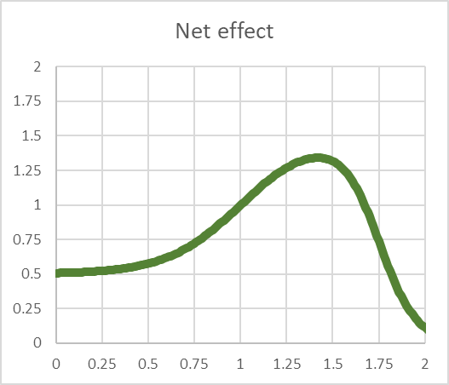
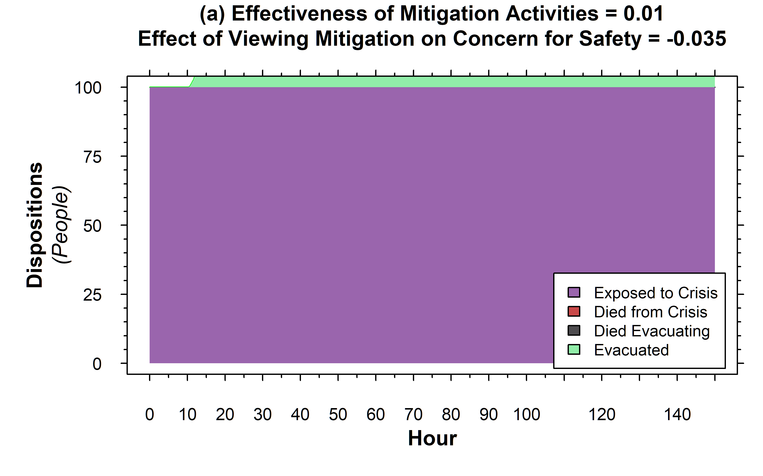
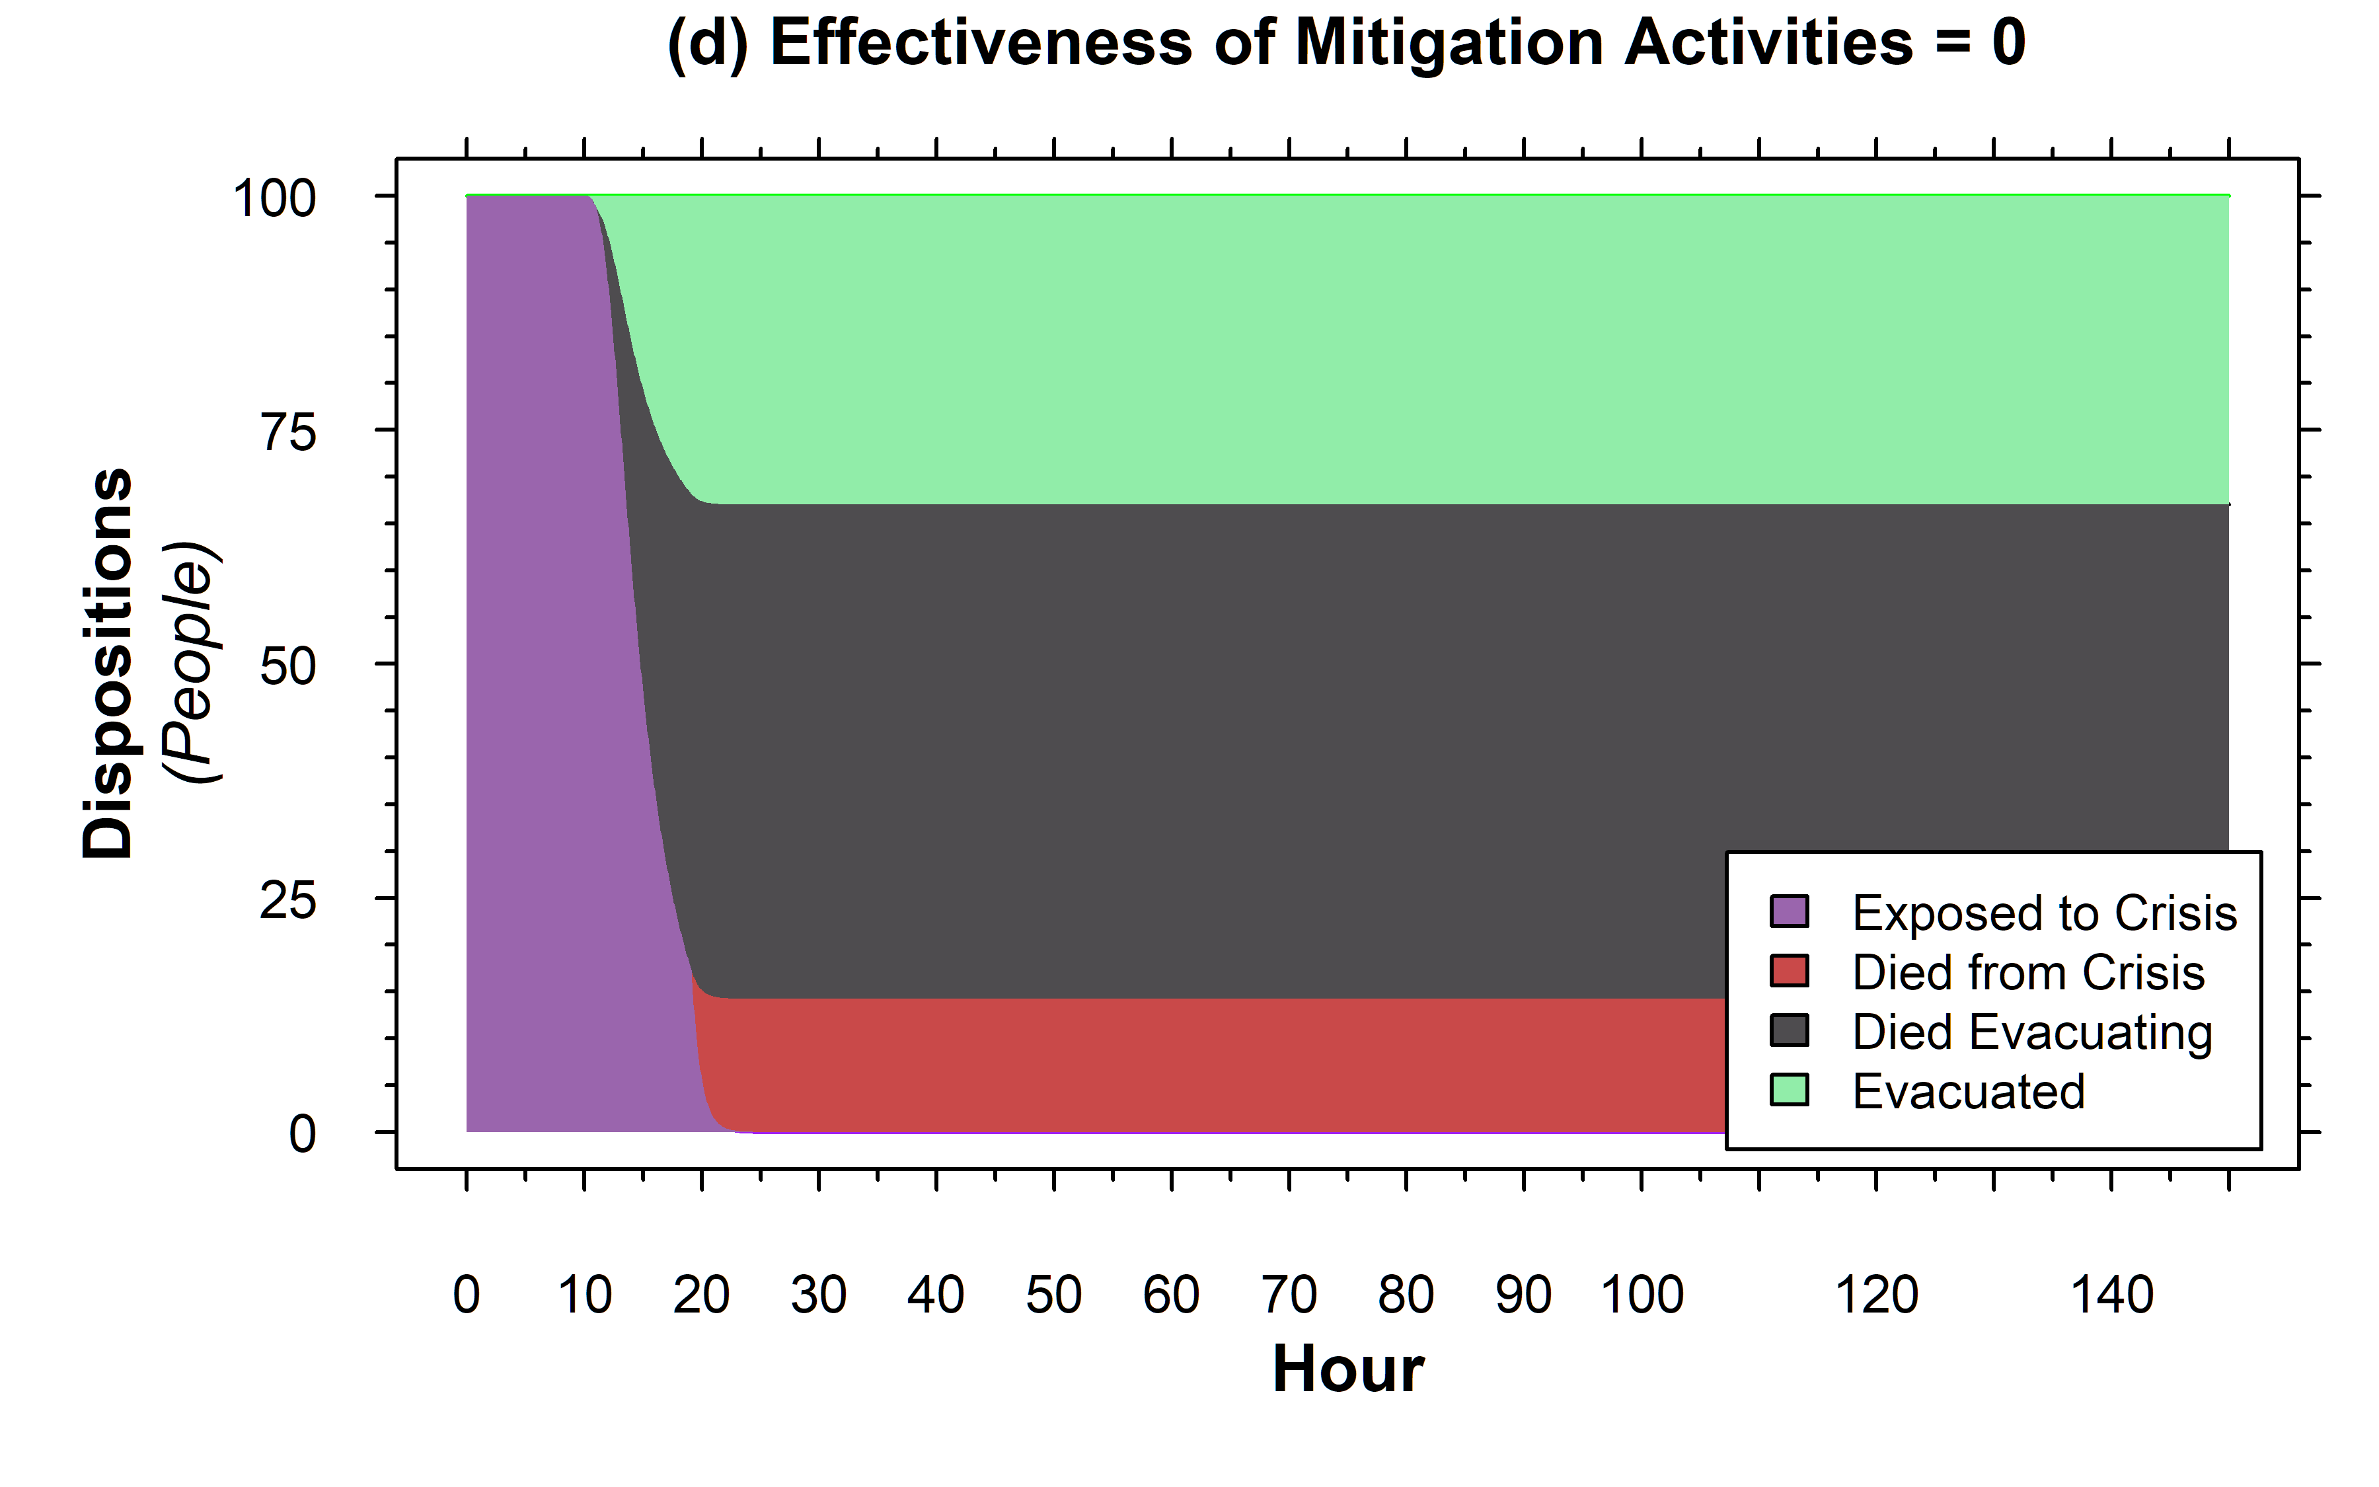
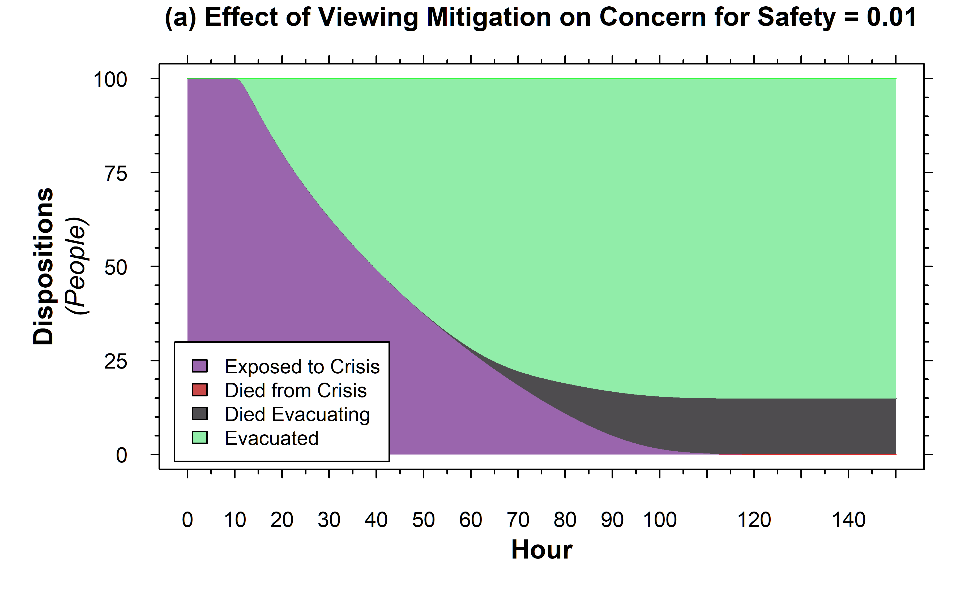
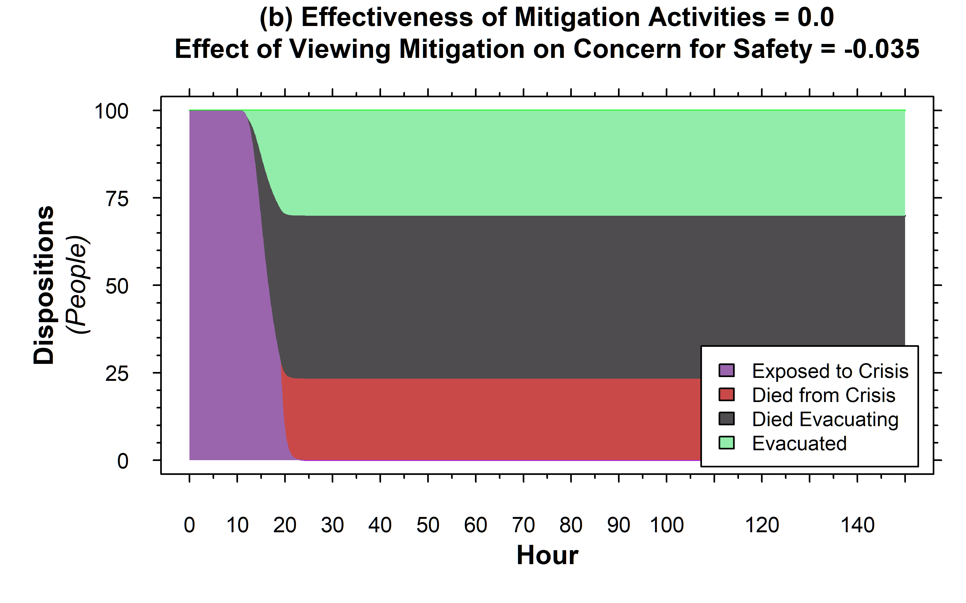
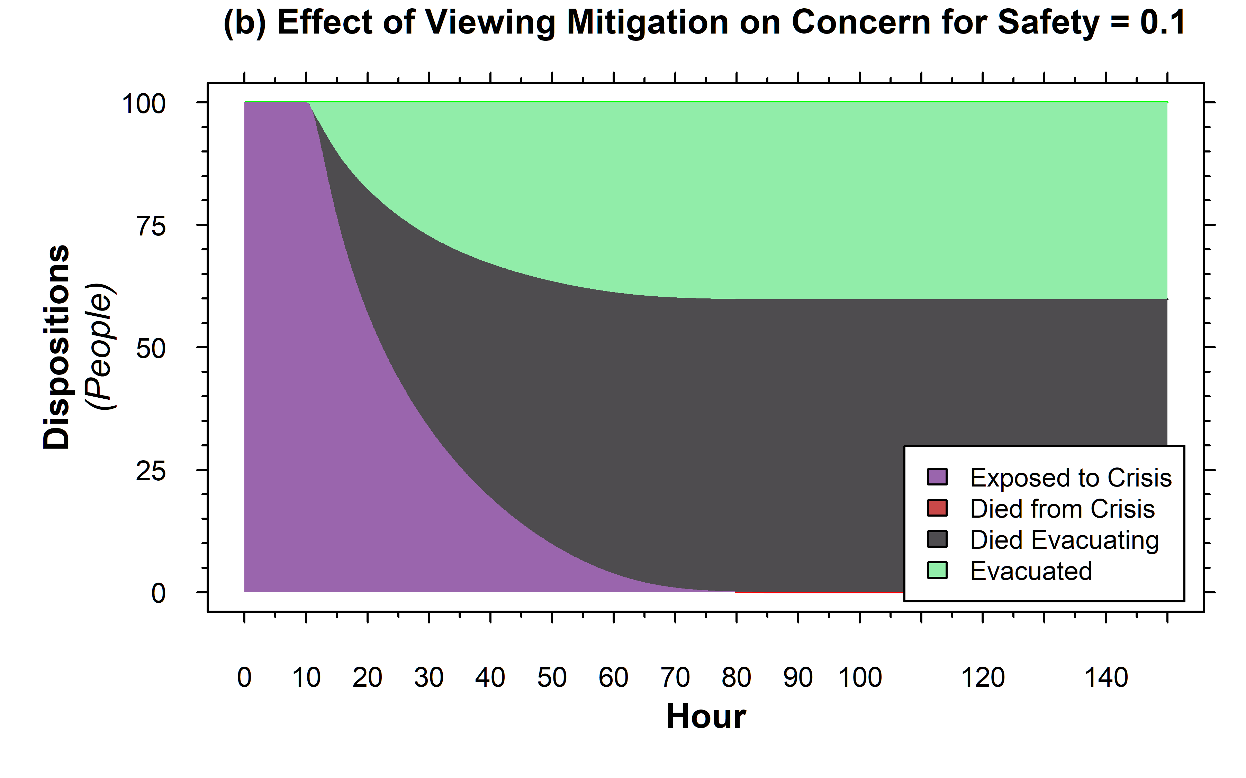

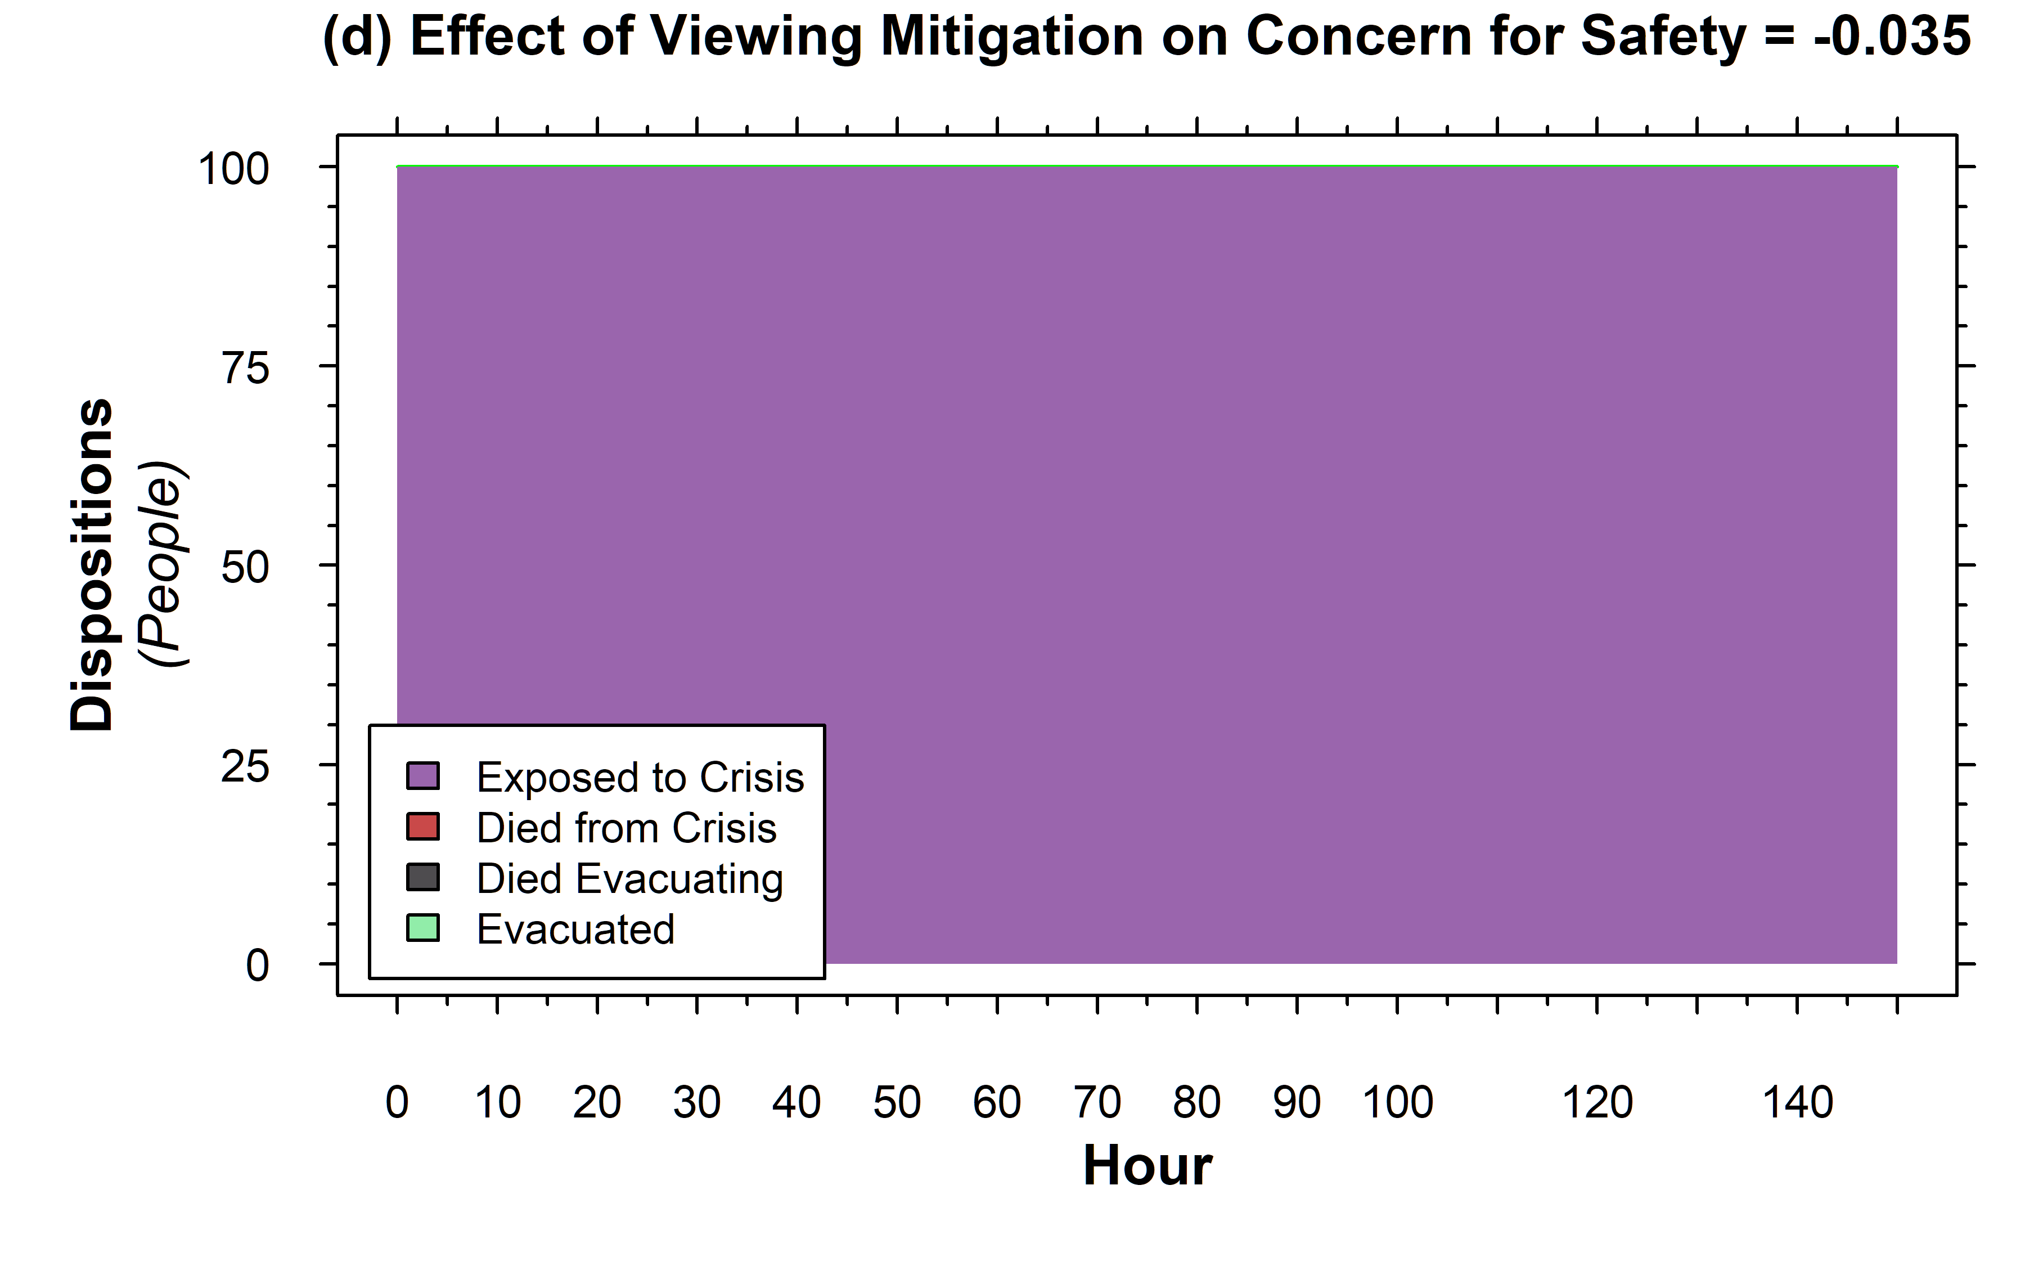
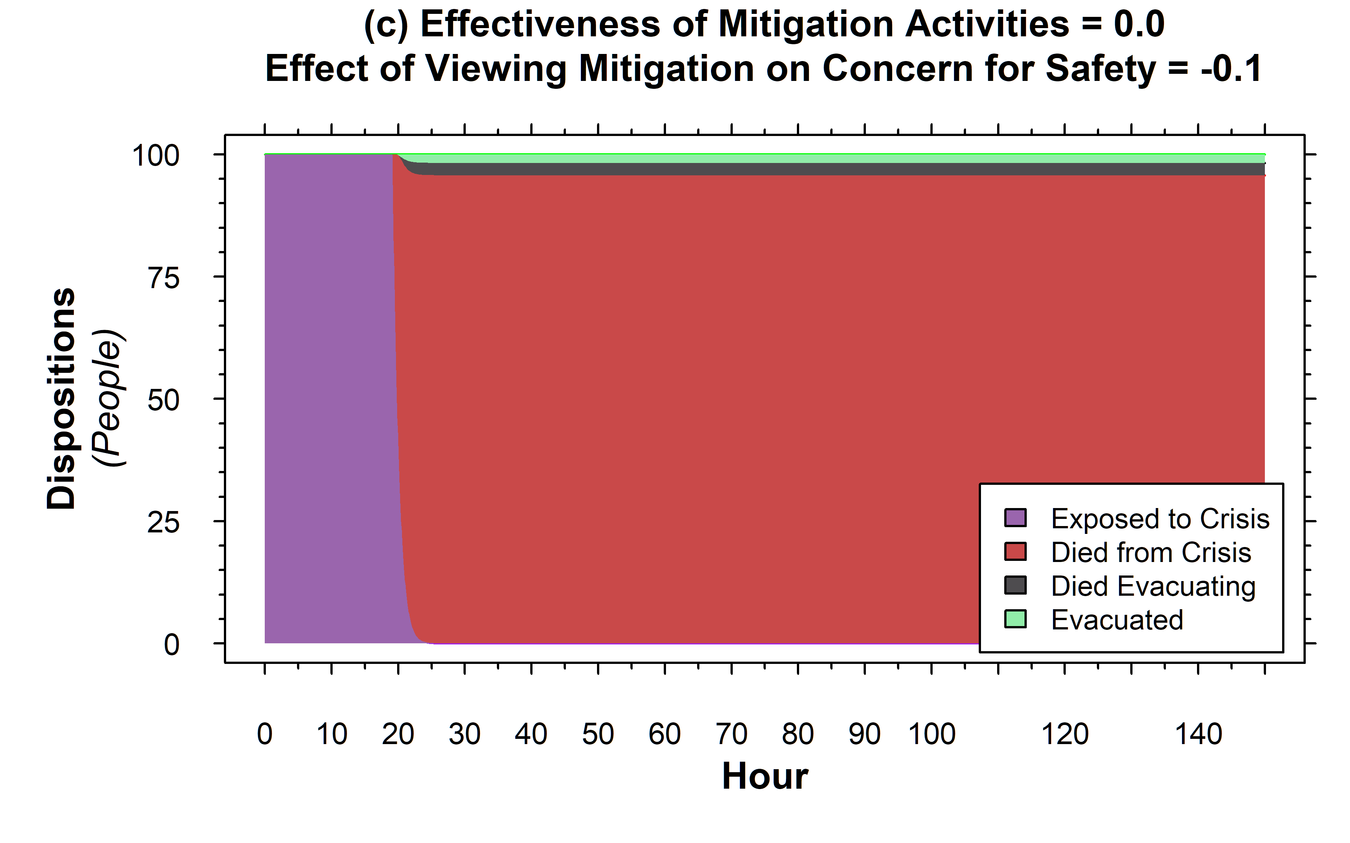
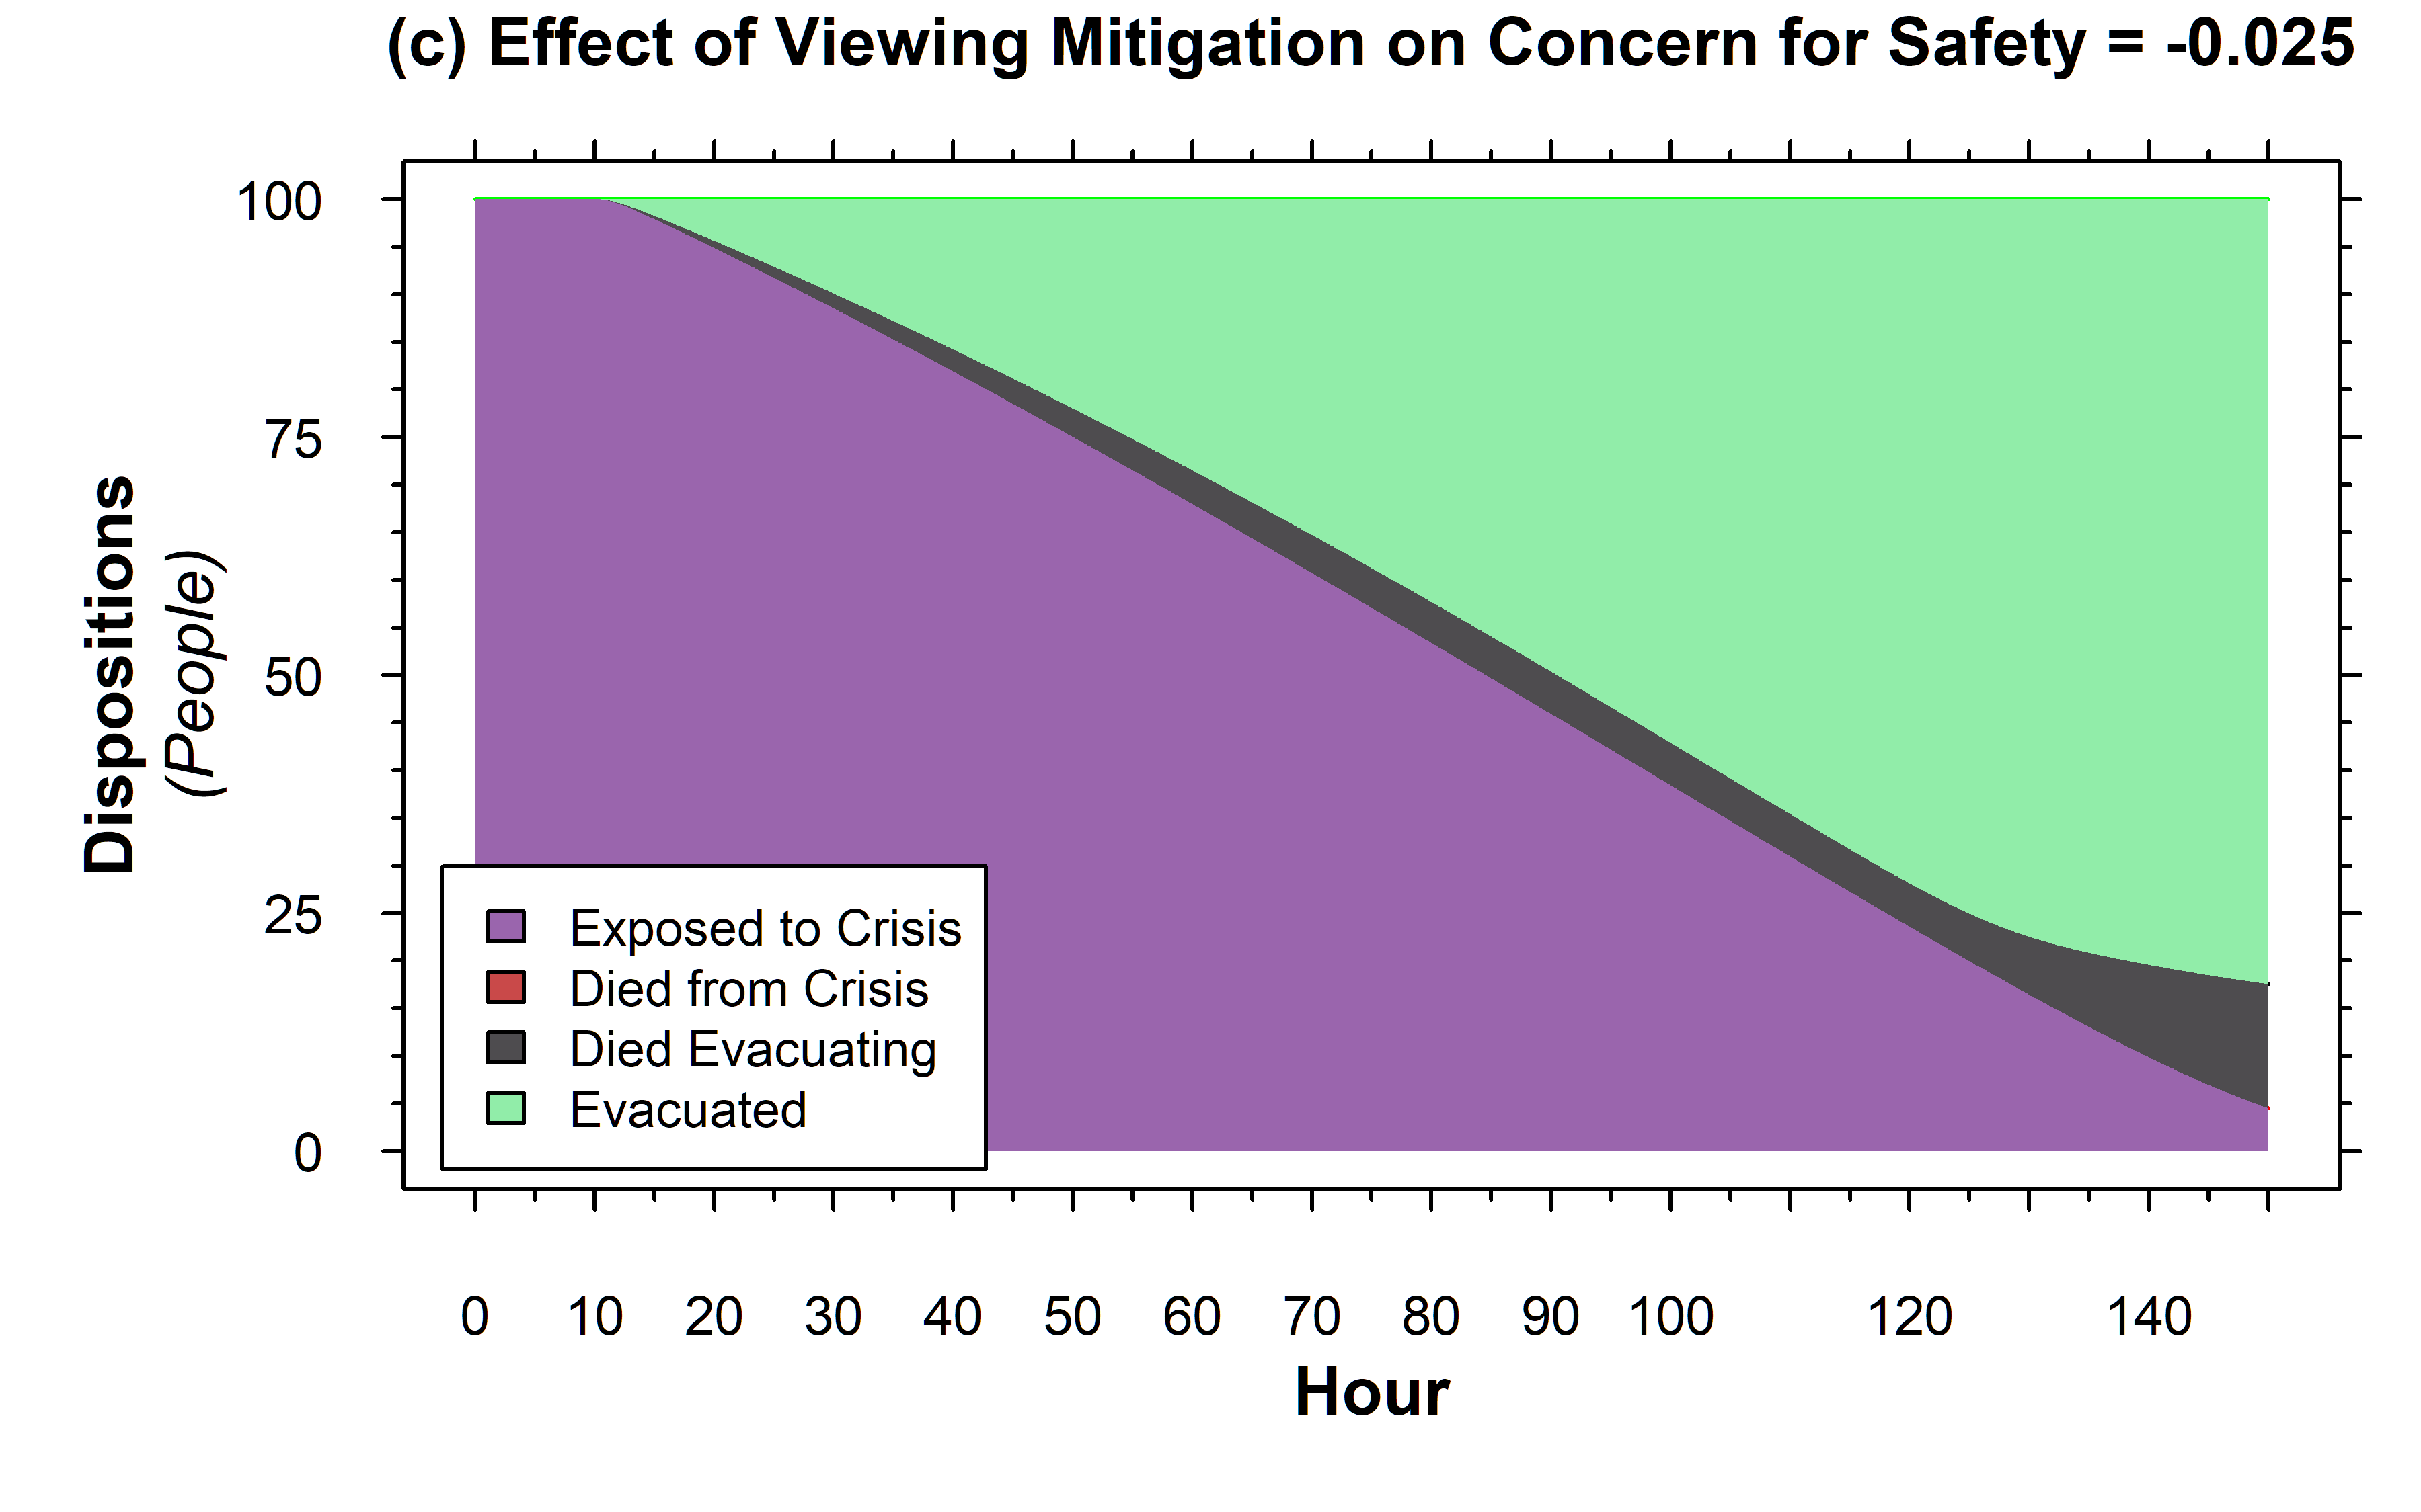

Rearranging the Deck Chairs on the Titanic
A Simulation Model Of Behavioral Resource Utilization Under Crisis
James E. Paine MIT Sloan School of Management – System Dynamics Group
Background & Summary
“Rearranging the deck chairs on the Titanic is used metaphorically “to occupy oneself with some trivial activity while ignoring something much more important.”
Mitigation activities during crisis can have two purposes: buying time and calming people down.
Under what circumstances could “rearranging the deck chairs” or any possibly preventative, even seemingly trivial, activity during a crisis be helpful?
This work presents a compartmental differential equation model that explores the interplay of stress response and action efficacy in group survivability during a crisis
Highlights that calming but even marginally effective mitigation activities can stabilize or improve crisis outcomes, while a calming but totally non-effective mitigation activity can severely worsen outcomes
Model Structure and Key Mechanisms
Context-Dependent ‘physics’ of the crisis are aggregated
Focus of this model is on behavioral responses and feedback
Capturing Effect of Stress on Performance
X
=
X
=
Crisis Mitigation can be stressful or calming
Evacuation is not Necessarily Successful
Reinforcing if sign on Effect is >0
Balancing if sign on Effect is <0
Evacuation Efficacy affected by stress response
Varying Stress Effect of Mitigation
Marginally Effective vs Ineffective Mitigation
Positive effect of calming lost when mitigation is totally ineffective
For very calming mitigation, can get ‘head in the sand’ outcome with negligible evacuation
This is ‘rearranging the deckchairs’ in the original meaning
Calming, but still marginally effective, mitigation can increase evacuation efficaciousness
Here, people don’t panic and flee, and instead spend effort maintaining system capability
Model Files & Additional Documentation

